Slide 1


Acknowledgement
Internal Guide : Mr. Gopal Sonune Sir
External Guide : Mr. Jaydeep Gore Sir

Slide 2
AGENDA
Problem Definition
Scope
Software/Hardware Requirements
Literature Survey
Proposed System
Design of Proposed system(Use case Diagram)
Implementation
What we will do next ?
References

Slide 3
Problem Definition
Reality :
“Information is the oil of the 21st century, and analytics is the combustion engine.”
Problem:
Testing is challenging for large scale data acquisition system

Slide 4
SCOPE
SCOPE
Development of digital pulse emulator
Data that needs to be analyzed and probed will be considered
Involves developing routines in C
Input: Probability and amplitude spectrum
Output: Generation of pulses
Solution

Slide 5
SOFTWARE REQUIREMENTS
Xilinx Vivado
Gcc compiler
HARDWARE REQUIREMENTS
Zynq development board with FMC connectors
High speed data acquisition
FMC card with on board two analog inputs and outputs
Power supply adapter

Slide 6
Literature Survey
Configurable Digital Emulation of Radiation Sources
[Abbiati, Sebastiano Scarpaci, Angelo Geraci, Giancarlo Ripamonti
2009 IEEE Nuclear Science]
Output of the FPGA device enters an analog front-end that plays the role of a classic preamplifier.
In this way, the system actually can emulate the cascade of source, detector and preamplifier section.

Slide 7
Literature Survey
Occurrence time values that occur according to an assigned statistic distribution.
Multichannel Digital Emulator of Radiation Detection Systems
[J.Millman, A.Grabel, Microelectronics&quot;, McGraw-Hill, 198]
The performances of the instrument mainly depend on a good pseudorandom generation process.

Slide 8
Literature Survey
In order to test the realized LFSR statistic generator, different realizations of streams of pseudorandom values have been extracted from the FPGA.
In order to verify uniformity and independence of the generated values, chi-square tests have been performed.

Slide 9
Literature Survey
FPGA-based random pulse generator for emulation of a neutron detector system in a nuclear reactor.
[Abbiati, Sebastiano Scarpaci, Angelo Geraci, Giancarlo Ripamonti
2009 IEEE Nuclear Science]
A Fast, Programmable, Stand-Alone Pulse Generator Emulating Spectroscopy Nuclear Events
[J.Millman, A.Grabel, Microelectronics&quot;, McGraw-Hill, 198]

Slide 10
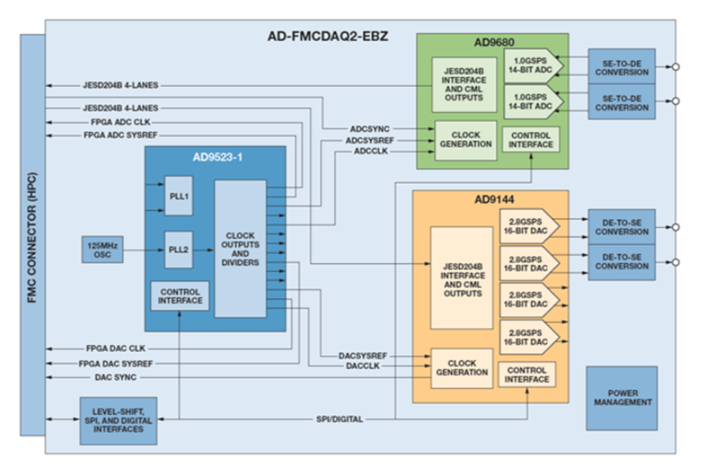
Proposed System

Slide 11
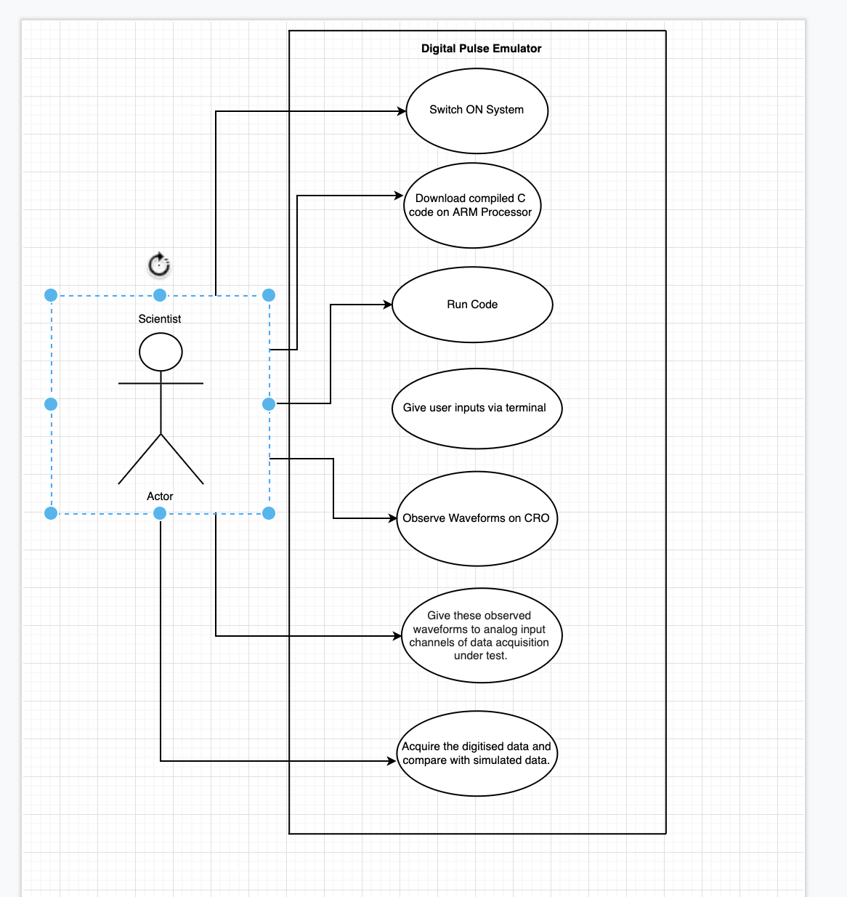
Design of Proposed System

Slide 12
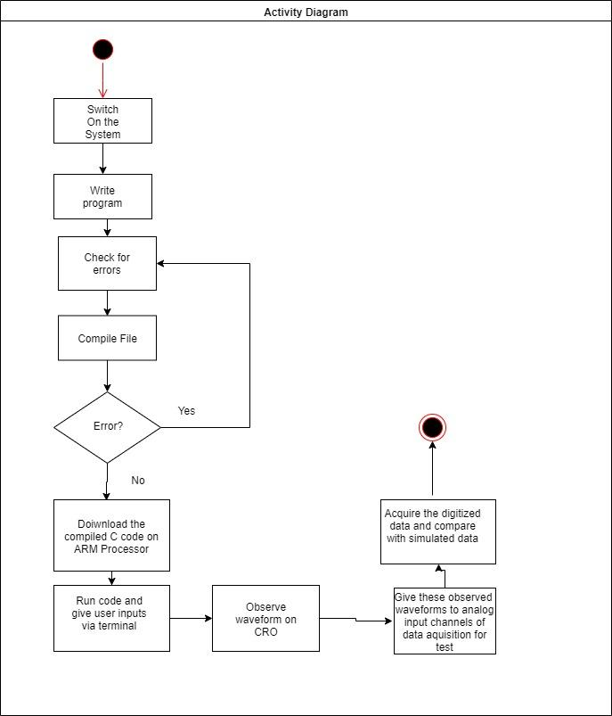
Activity Diagram

Slide 13
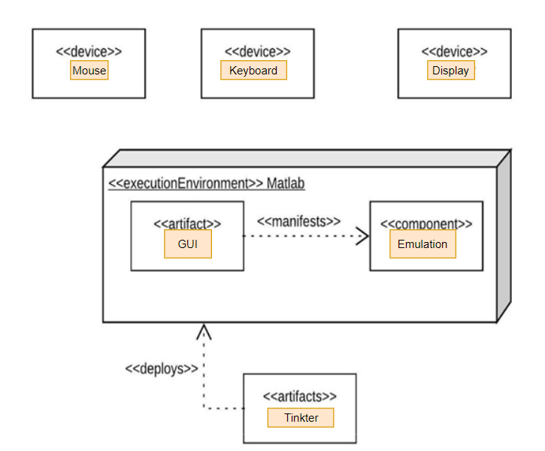
Deployment Diagram

Slide 14
Implementation
Drive Link
https://drive.google.com/drive/folders/1hHNOQVkdC4wC8A_7jJK6jPLPAvFuIax1?usp=sharing
Tools used
GCC Compiler, Python3, Tkinter GUI Tool and Matplotlib

